Slide 1
Chopin: Prelude Number 15 in Db Major "Raindrop"
Opus 28

Slide 2
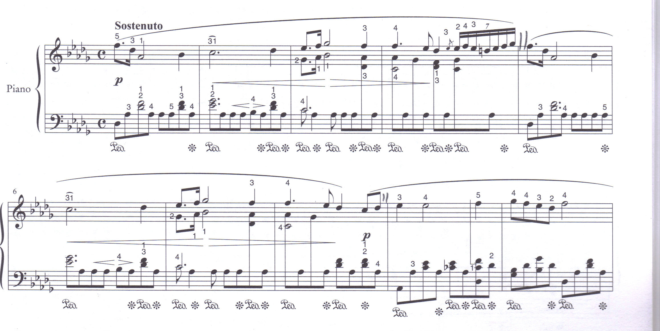
Section A
Db major
ornamented
Acciaccatura (crushed note)
F Db Ab raindrop motif
Stepwise melody in right hand
Septuplet
Sustained
Piano
turn
Ic
V7 I
Sustain Pedal
Release Pedal
2nd theme stepwise melody
Bars 5 – 8 are a repeat of 1 - 4
Bars 8 -12
Harmony – simple diatonic mainly chords I and V7
Melody dominated Homophonic texture
Strong quaver rhythm throughout (raindrops)
LEGATO (smooth) CANTABILE (singable/songlike) melody throughout
This melody undergoes variation every 4 bars
Lots of RUBATO (stretched) throughout to add expression

Slide 3
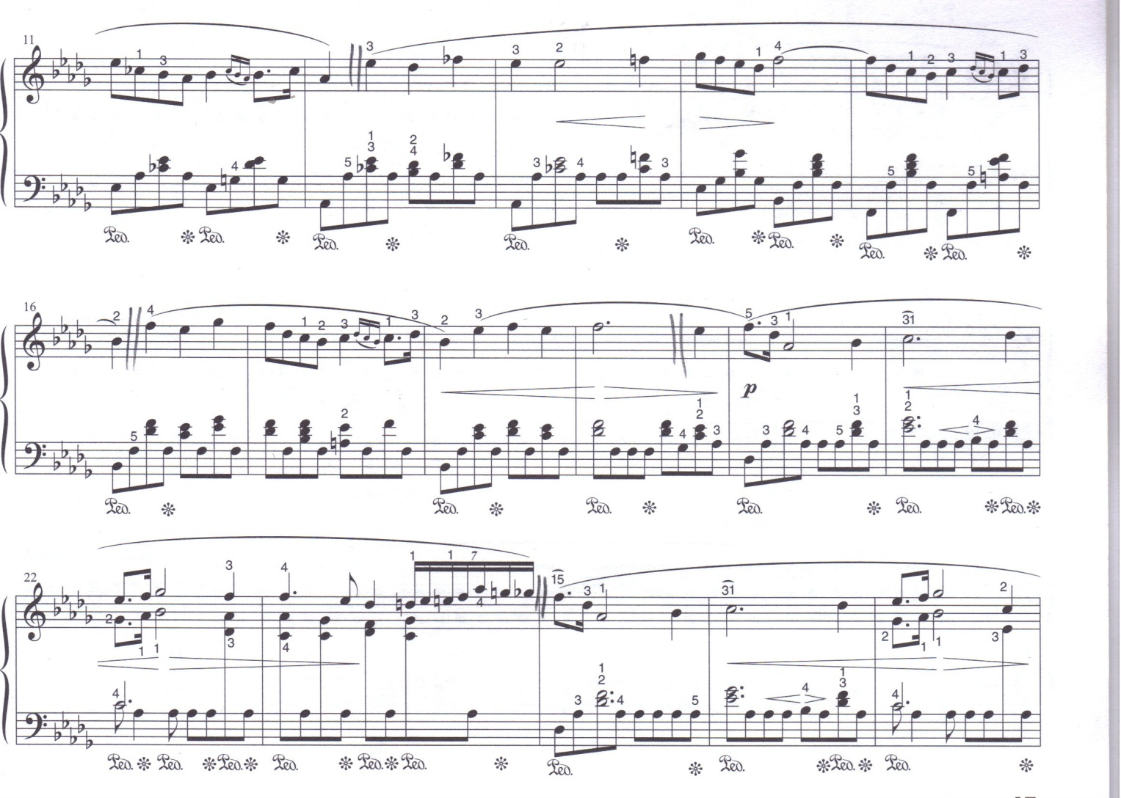
Hinting at Ab minor
Pivot note
turn
Modulatory passage
Variant of previous 4 bar melody
Occasional chromatic note to add colour to harmony
Bb minor (relative minor)
V I
V
Modulating to Ab major (dominant key) moving to Ab Minor
2 bar phrases based on 2nd part of theme
Reprise of opening theme
I
Bb minor
Db major
Left hand chordal filling out texture
Chromatic septuplet
Opening theme once more

Slide 4
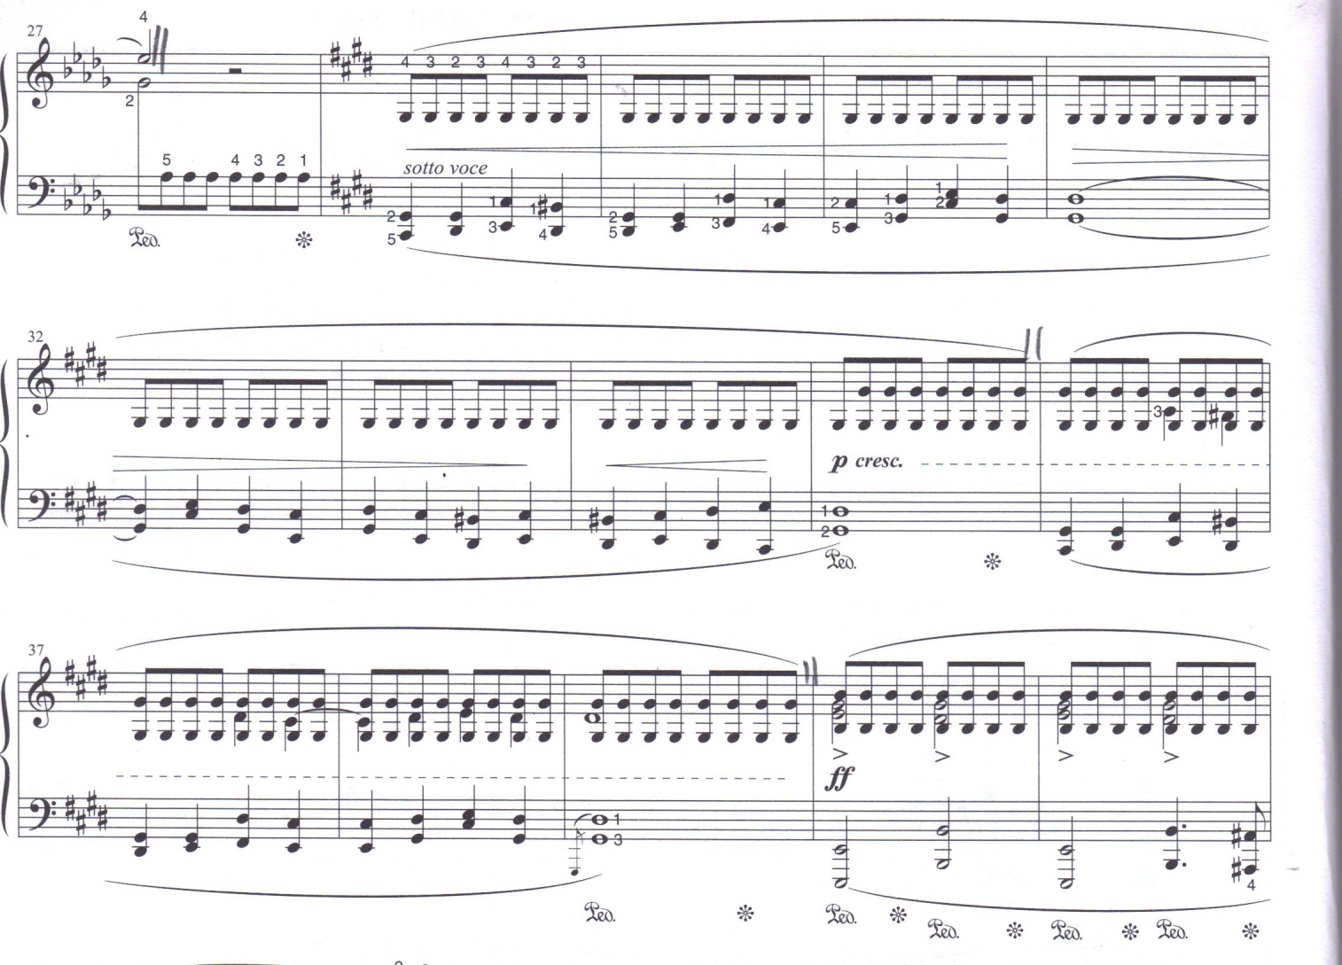
Section B
Ab = G# (Enharmonic) pivot note
Repeated Ab/G# taken over by right hand now providing accompaniment (constant raindrops)
whisper
C# minor – enharmonic tonic minor to Db Major)
Dominant chord with 3rd missing sounds bare
Dominant 7th chord
STORM - BELL TOLLING
Dominant chord with 3rd missing
Octave G# added
Two four bar phrases in a chorale like crotchet melody
Crescendo to bar 40 = fortissimo
These 4 bars in G# minor
Dramatic E major chord VI
36 – 39 repeat of 28 – 31 but with added inner crotchet melody doubling top notes of left hand in octaves = thicker texture
Strong octaves in bass and treble minim chords in right hand with accents

Slide 5
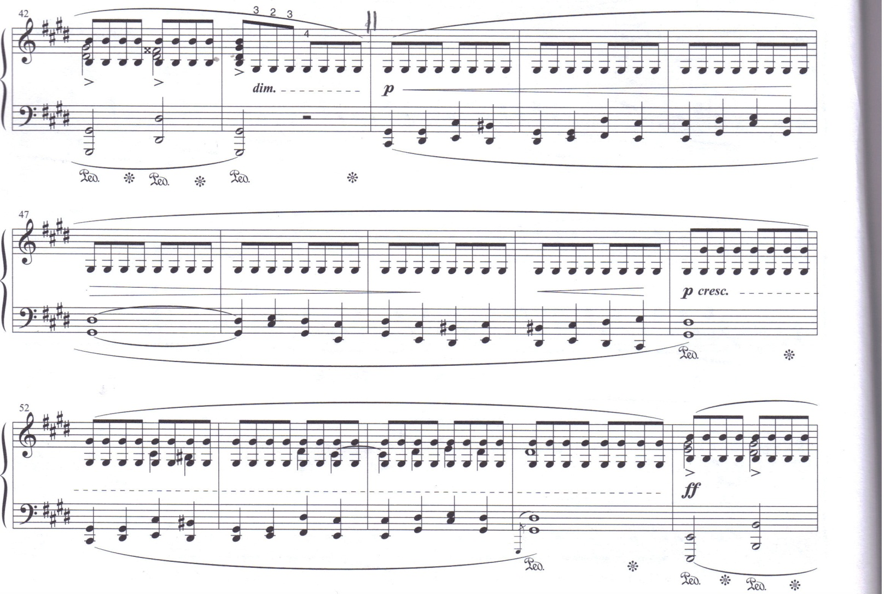
Dominant of C# minor
V I
Texture thins dramatically to piano quaver G#s as a reprise to section only difference is slight dynamic changes)

Slide 6
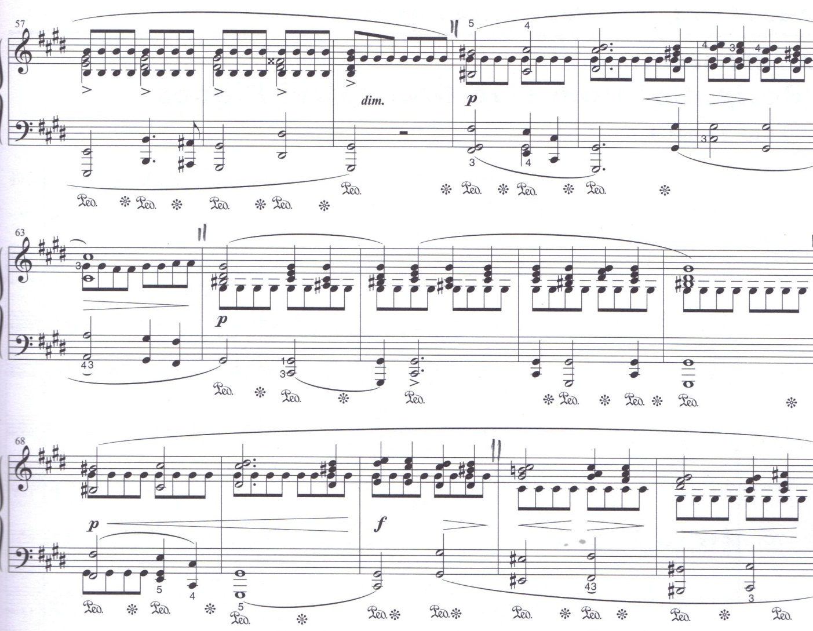
Back in C# minor, melody moves to top of texture chorale like moving up and down in step
Augmented longer notes of first part of section B, repeated G#s now in the middle of the texture
Static Harmony chords
V I V I V I
Dominant pedal notes in bass and repeated quavers in middle part G#s) = PEDALS
Forte passage
68 – 70 repeat of 60 - 62
F# minor
C# minor

Slide 7
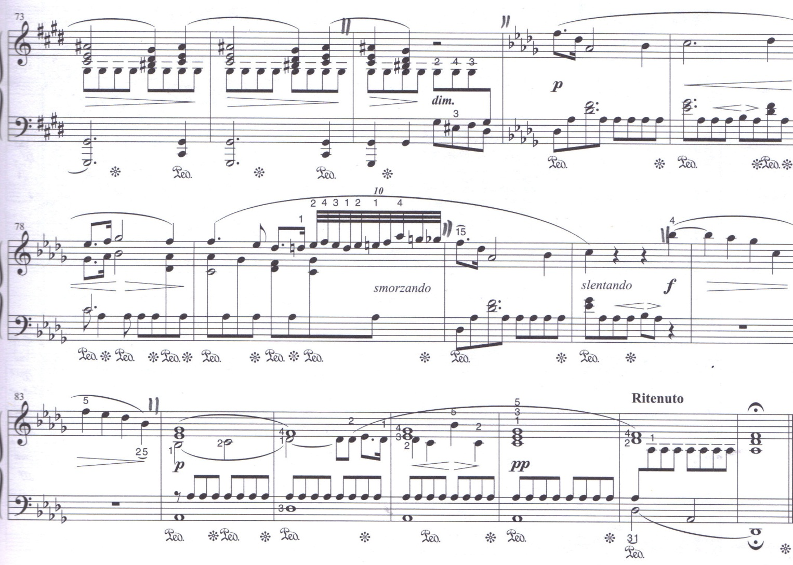
A# Chromatic note in C# minor = Added 6th chord = C# E G# A#
Reprise of Opening Section A
Piano section
Three repetitions of note sequence A# A# G
Link bar = G# E# F# D# Enharmonic of Ab F Eb Db to lead us seamlessly back to Db Major
Mini cadenza
Broken opening theme
Gradually slower
Bb = highest note in the piece
Dying away
forte
2 bar
monophonic
melody
Now 10 notes long
Gradually slower
melody
Inner pedal Abs
pianissimo
diminuendo
V I V V I I
6 bar phrase to end

Slide 8
Pedals
Pedal in lowest part = pedal
Pedal in middle part = inner pedal
Pedal in highest part = inverted pedal
BACK

